Slide 1

Database Security, Authorization and Access Control
Database Management System | Storage Structures, Indexing and Query Optimization
Course: Database Management System | Chapter: Storage Structures, Indexing and Query Optimization | Program: B.TECH-CSE, B.TECH CSE - CYBER SECURITY, B.TECH CSE - DATA
DISCOVER · LEARN · EMPOWER
Notes:
Welcome everyone to this lecture on Database Security. We are focusing on how we protect data within the storage structures and indexing layers. Remember, security is not an afterthought but a fundamental requirement for any robust database system. Let us begin by understanding the core mechanisms that keep our data safe.

Slide 2
Course Outcomes
SLIDE 2 / 14
Course Outcome
CO | BT LEVEL | DESCRIPTION
CO1 | BT2 | Explain database architecture, relational model concepts and formal query language foundations including relational algebra and relational calculus.
CO2 | BT3 | Apply relational algebra, relational calculus and SQL constructs to formulate correct and efficient database queries.
CO3 | BT4 | Analyze functional dependencies and design normalized relational schemas up to 5NF ensuring lossless join and dependency preservation.
CO4 | BT4 | Analyze transaction schedules and concurrency control mechanisms to determine serializability, recoverability and correctness.
CO5 | BT5 | Evaluate storage structures, indexing strategies and query optimization techniques for performance, scalability and reliability.
Chandigarh University
2 / 14
Notes:
This lecture directly supports our first two course outcomes. CO1 requires you to explain the architecture, which includes the security layer as a critical component. CO2 asks you to apply SQL constructs, and authorization commands like GRANT and REVOKE are essential SQL tools for managing access.

Slide 3
Learning Objectives
SLIDE 3 / 14
Learning Outcomes
1
Define the core concepts of database security and confidentiality.
2
Explain the role of authorization in controlling user access levels.
3
Describe the mechanisms of access control lists and role-based models.
4
Analyze how security policies impact query optimization strategies.
5
Identify common vulnerabilities in database storage and indexing layers.
Chandigarh University
3 / 14
Notes:
By the end of this session, you will be able to define security concepts clearly. You will understand how authorization acts as a gatekeeper for our data. We will also explore how these security mechanisms interact with the underlying storage structures and indexing methods we studied earlier.

Slide 4
Lecture
SLIDE 4 / 14
Core Concepts of Database Security
1
Database security ensures confidentiality, integrity, and availability of stored data.
2
Confidentiality prevents unauthorized users from reading sensitive information.
3
Integrity ensures data remains accurate and unaltered during storage operations.
4
Availability guarantees that authorized users can access data when needed.
5
Security mechanisms must be integrated into storage structures and indexes.
Chandigarh University
4 / 14
Notes:
Think of the CIA triad as the foundation of all security. Confidentiality is like locking a diary so only you can read it. Integrity ensures no one has tampered with the pages. Availability means the diary is not lost or destroyed. In our context, these must apply to how data is stored and indexed.

Slide 5
Lecture
SLIDE 5 / 14
Authorization and User Roles
1
Authorization determines what actions a user can perform on data.
2
Users are assigned specific roles based on their job responsibilities.
3
Roles simplify management by grouping permissions for multiple users.
4
Privileges include SELECT, INSERT, UPDATE, and DELETE operations.
5
Granular control allows restricting access to specific tables or columns.
Chandigarh University
5 / 14
Notes:
Authorization is the process of granting or denying permissions. Instead of assigning rights to every individual, we use roles. For example, a 'Student' role might have read-only access to grades, while a 'Professor' role can update them. This reduces administrative overhead significantly.

Slide 6
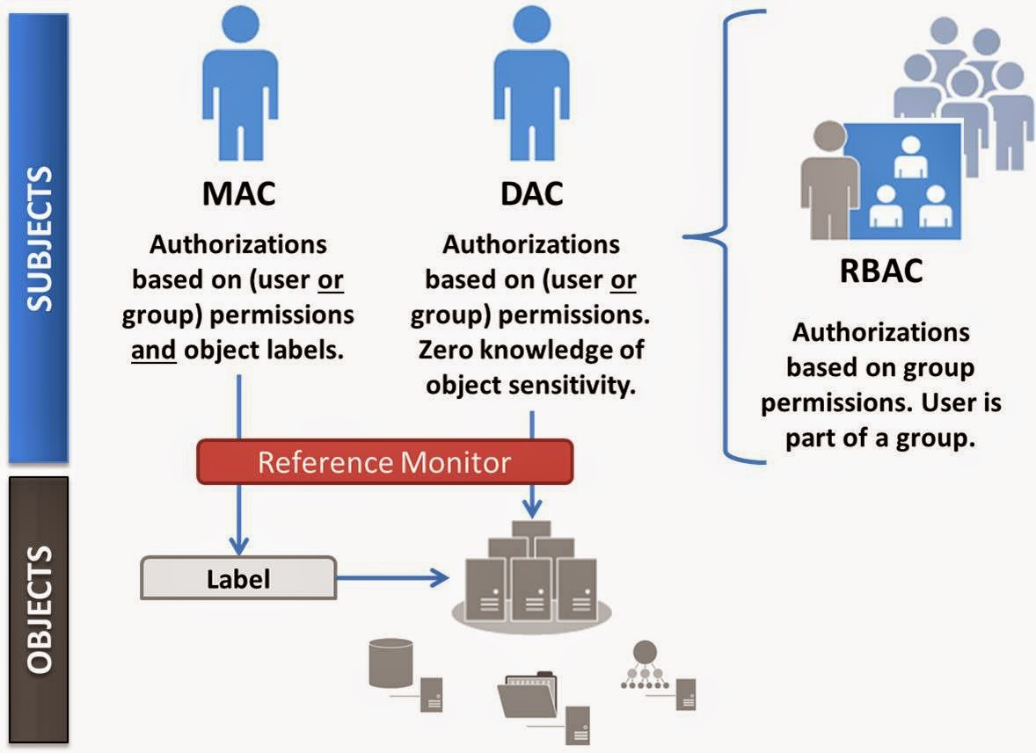
Lecture
SLIDE 6 / 14
Access Control Models Overview
1
Discretionary Access Control (DAC) lets owners define their own rules.
2
Mandatory Access Control (MAC) enforces strict system-wide security policies.
3
Role-Based Access Control (RBAC) assigns permissions to roles, not users.
4
Attribute-Based Access Control (ABAC) uses attributes to make decisions.
5
RBAC is the most common model in modern enterprise database systems.
Source: blogger.googleusercontent.com
Chandigarh University
6 / 14
Notes:
There are several models for controlling access. DAC is like a house owner deciding who enters. MAC is like a military base where only specific clearance levels work. RBAC is the standard for universities and businesses because it scales well with large user groups.

Slide 7
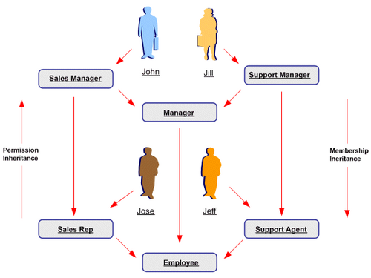
Lecture
SLIDE 7 / 14
Role-Based Access Control (RBAC)
1
RBAC maps users to roles and roles to permissions efficiently.
2
Users inherit all permissions associated with their assigned roles.
3
Hierarchical roles allow senior roles to inherit permissions from junior ones.
4
Separation of duties prevents conflicts of interest in critical operations.
5
RBAC simplifies auditing and compliance reporting for security teams.
Source: www.oracleug.com
Chandigarh University
7 / 14
Notes:
In RBAC, a user is a member of a role, and a role has permissions. If you are a 'Manager', you might inherit all permissions of a 'Staff' member plus the ability to approve requests. This hierarchy makes it easy to manage complex access needs without creating unique rules for every person.

Slide 8
Lecture
SLIDE 8 / 14
SQL Authorization Commands
1
The GRANT command assigns specific privileges to users or roles.
2
The REVOKE command removes previously assigned privileges from users.
3
Commands can target specific tables, views, or entire database schemas.
4
WITH GRANT OPTION allows users to pass privileges to others.
5
SQL standard defines syntax for managing access control effectively.
Chandigarh University
8 / 14
Notes:
We use SQL commands to implement these models. The GRANT command gives permissions, while REVOKE takes them away. For instance, granting SELECT on a table allows a user to read data. The WITH GRANT OPTION is powerful but risky if given to untrusted users.

Slide 9
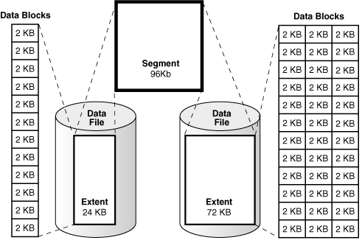
Lecture
SLIDE 9 / 14
Security in Storage Structures
1
Data at rest must be encrypted within physical storage blocks.
2
Index structures require encryption to prevent inference attacks.
3
Access control lists are stored alongside data pages for quick lookup.
4
Physical security prevents unauthorized access to disk drives and servers.
5
Encryption keys must be managed separately from the data itself.
Source: docs.oracle.com
Chandigarh University
9 / 14
Notes:
Security isn't just logical; it's physical too. Data sitting on a hard drive is vulnerable if the drive is stolen. We encrypt data at rest so that even if someone steals the disk, they cannot read the information. Indexes also need protection to hide data patterns.

Slide 10
Lecture
SLIDE 10 / 14
Security in Indexing Mechanisms
1
Indexes can inadvertently leak information through access patterns.
2
Search patterns on encrypted indexes may reveal data distribution.
3
Secure indexing requires techniques like oblivious RAM or oblivious search.
4
Access control must apply to index traversal operations as well.
5
Optimization must balance security overhead with query performance.
Source: assets.algo.monster
Chandigarh University
10 / 14
Notes:
Here is a critical point: indexes can leak information. If an attacker sees which index nodes you access, they might guess what data you are looking for. We need secure indexing techniques that hide these access patterns while still allowing efficient queries.

Slide 11
Worked Example
SLIDE 11 / 14
Granting Privileges
SCENARIO
Professor needs to view grades but not modify them.
COMMAND
GRANT SELECT ON Grades TO Professor;
SCENARIO
Student needs to view their own grades only.
COMMAND
GRANT SELECT ON Grades TO Student;
RESULT
Professor sees all rows; Student sees filtered rows.
Chandigarh University
11 / 14
Notes:
Let's look at a concrete example. We grant SELECT permission to a Professor on the Grades table. This allows them to see all student grades. We also grant SELECT to a Student, but with a view that filters rows. This ensures they only see their own data, maintaining privacy.

Slide 12
Lecture
SLIDE 12 / 14
Common Security Pitfalls
1
Over-privileged accounts increase the risk of data breaches significantly.
2
Hardcoded passwords in application code are a major vulnerability.
3
Ignoring index security can lead to information leakage attacks.
4
Failing to revoke access when users change roles creates risks.
5
Lack of audit logs makes detecting breaches extremely difficult.
Chandigarh University
12 / 14
Notes:
There are common mistakes we must avoid. Giving everyone 'admin' access is a huge risk. Hardcoding passwords in scripts is dangerous because they can be exposed in version control. Also, forgetting to remove access when a student graduates leaves data vulnerable.

Slide 13
Lecture
SLIDE 13 / 14
Key Takeaways
1
Security ensures confidentiality, integrity, and availability of database data.
2
Authorization controls user actions through roles and privileges.
3
RBAC is the preferred model for managing complex access requirements.
4
Encryption and secure indexing protect data in storage structures.
5
Proper SQL commands like GRANT and REVOKE enforce access rules.
Chandigarh University
13 / 14
Notes:
To summarize, security is about protecting data through the CIA triad. We use authorization and roles to manage who can do what. RBAC is the most efficient way to handle this in large systems. Finally, remember that storage and indexing layers also need specific security measures.

Slide 14
Lecture
SLIDE 14 / 14
References
1
Fundamentals of Database Systems — Ramez Elmasri & Shamkant B. Navathe
2
Database System Concepts — Silberschatz, Korth & Sudarshan
3
Database Management Systems — Raghu Ramakrishnan & Johannes Gehrke
4
Oracle/MySQL Documentation — Oracle
Chandigarh University
14 / 14
Notes:
These are the standard textbooks and documentation we recommend for further reading. Elmasri and Navathe provide a deep dive into database architecture. Silberschatz offers excellent coverage of security concepts. Ramakrishnan and Oracle documentation provide practical implementation details.

